Slide 1
Computational Chemistry
Lecture 5: Exploring Potential Energy Surface – Geometry Optimization

Slide 2
Optimization algorithms
Finding the “optimum” geometry of a molecule = finding a minimum point on potential energy surface
The mathematical problem: optimization in more than one dimension
Optimization algorithms:
Steepest descent
Conjugate gradient
Quasi-Newton Raphson
Geometry Direct Inversion in the Iterative Subspace (GDIIS)

Slide 3
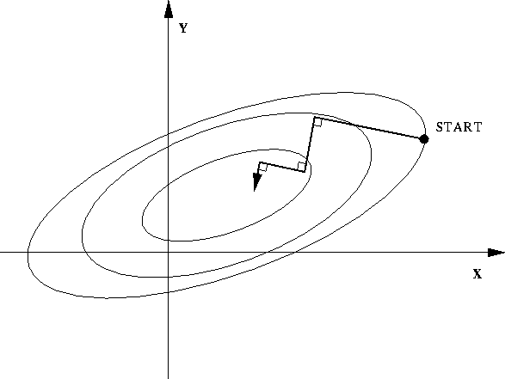
Steepest descent
Some set of coordinates R, E_{PES} and gradient g
Move atoms in direction of –g,
i.e. find λ such that coordinates
R ′= R− λg have minimum energy
Repeat starting from updated R′ until ΔE_{PES} or g is sufficiently small
Loses information about previous steps
Converge very slowly near a minimum
The method of Steepest Descent approaches the minimum in a zig-zag manner, where the new search direction is orthogonal to the previous.

Slide 4
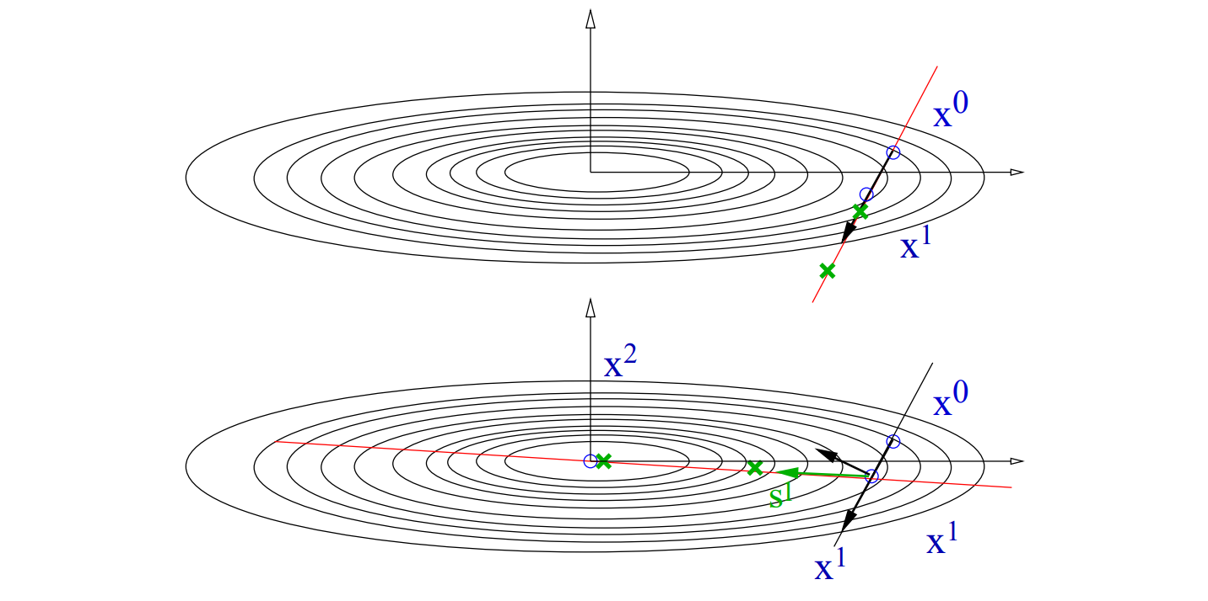
Conjugate gradient
Augment steepest descent with requirement to keep each step orthogonal to some number of previous steps.
Generally performs much better than steepest descent, and is often the first choice if far from an equilibrium geometry.
g₀
g₁
g₀

Slide 5
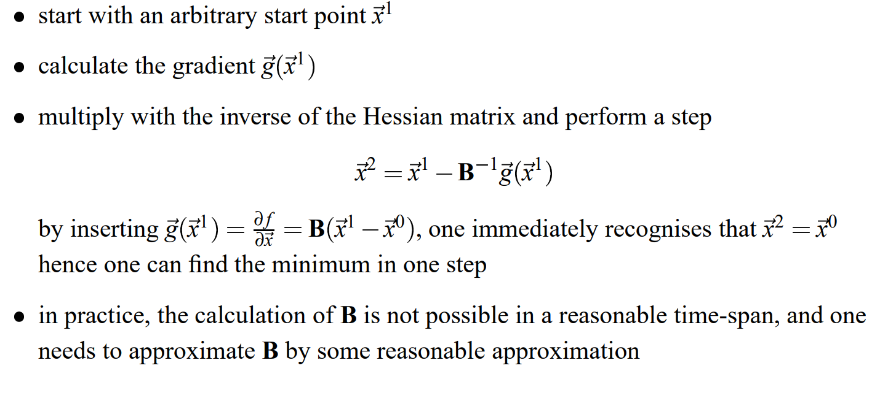
Quasi-Newton Raphson

Slide 6


Geometry Direct Inversion in the Iterative Subspace (GDIIS)
The size of a Newton-Raphson step H⁻¹ g gives some estimate of the error in the current position.
If we have a series of such steps, can predict the next step by requiring that it minimizes error from the previous ones.
Gives next step as linear combination of previous steps.

Slide 7
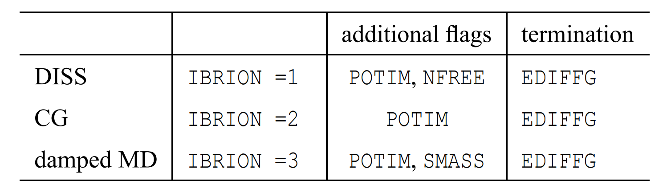
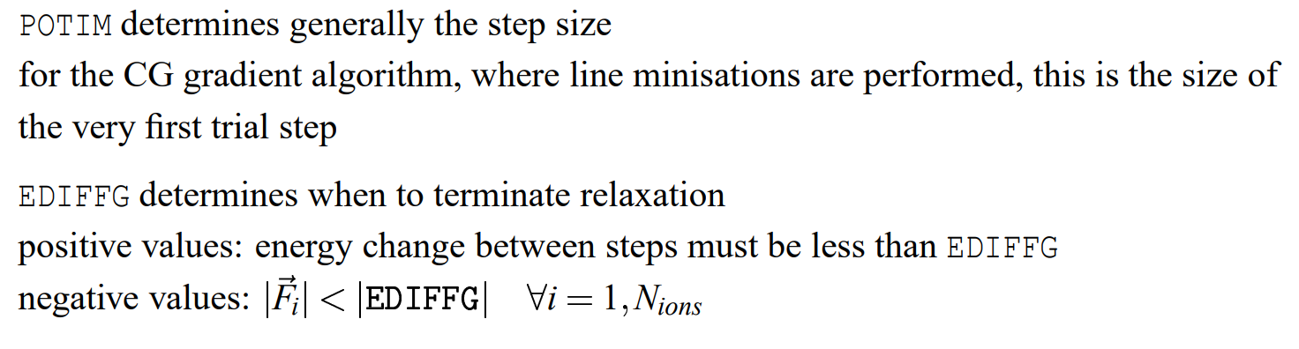
Ionic optimization algorithms in VASP
IBRION=1 should be used only close to the minimum with an already known setting for POTIM (determined with a run with IBRION=2).
DIIS

Slide 8
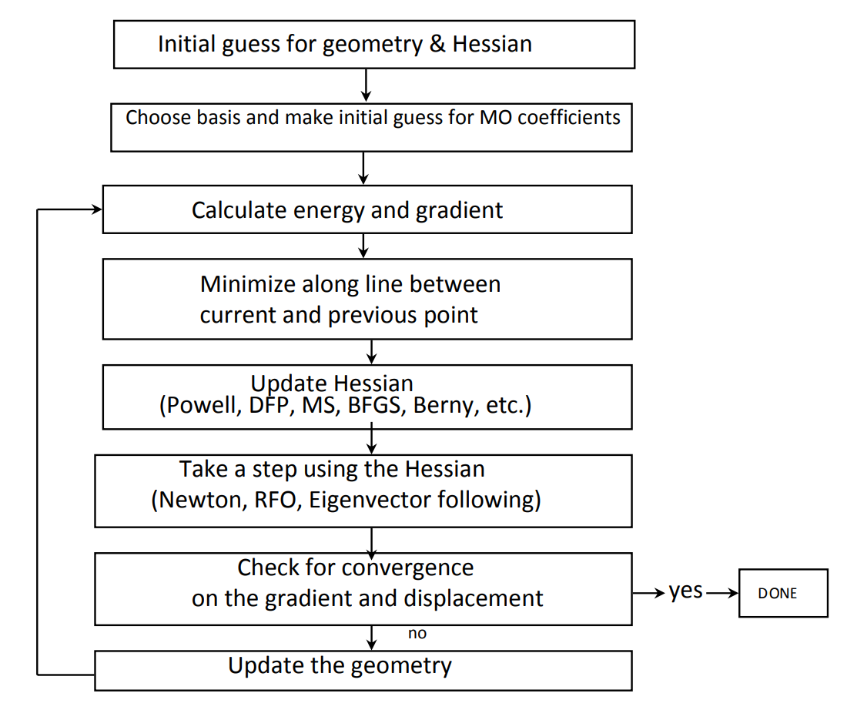
Algorithm for molecular geometry optimizations

Slide 9
Efficient coordinate systems
Multidimensional optimizations work best in coordinate systems in which the internal motions are as decoupled as possible.
Cartesian – simplest to implement, consistent performance. Typically only choice in supercell calculations.
Z-matrix – easy to use, easier to estimate initial Hessian. Has problems with rings or unusual coordination modes.
Natural internal – linear combinations of internals that match more closely to normal modes of molecules. Can work very efficiently, especially for ring systems, but are hard to generate automatically.
Redundant internal – produces an over-determined set of internal coordinates, like all bond distance, all angles between bonded atoms, all dihedrals. Construct Hessian guess using some sort of forcefield. Works very efficiently for molecules.

